Slide 1

SML Group Project
Prof: Minh Phan
Team Members: Omar ABDELGELIL
Xinghao ZONG
Lucas OLIVIER

Slide 2
Content Outline
1.
Data Preprocessing
2.
Model Building and Hyperparameter selection
3.
Experimental Setup, Variable selection and resampling
4.
Model Scoring and Model Assessment

Slide 3
Data Preprocessing

Slide 4

Dataset Description?
Challenge: Due to the high risks of computers getting infected by malware, MS want to predict if a machine will soon be hit with malware in order to improve their security measures.
Goal: Predict a Window’s Machine’s Probability of getting infected by various families.
  Train.csv: Will be used to train our model. 82 columns.
  Test.csv: Will be used as our testing dataset with the target of predicting the values for HasDetections column

Slide 5

Table Cleaning
Check the Class and Missing Value of each column
1
Change the type of some columns to numerics like Smode, AVProductsEnabled etc….
2
Fill missing value with “missing” for the factor columns
3
Convert all the of columns into integer and numeric values
4

Slide 6
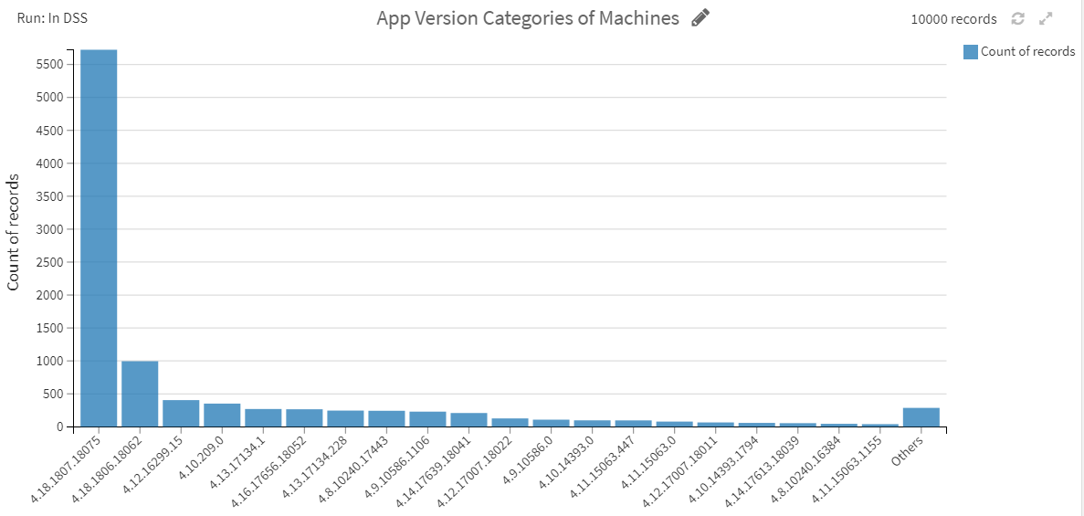
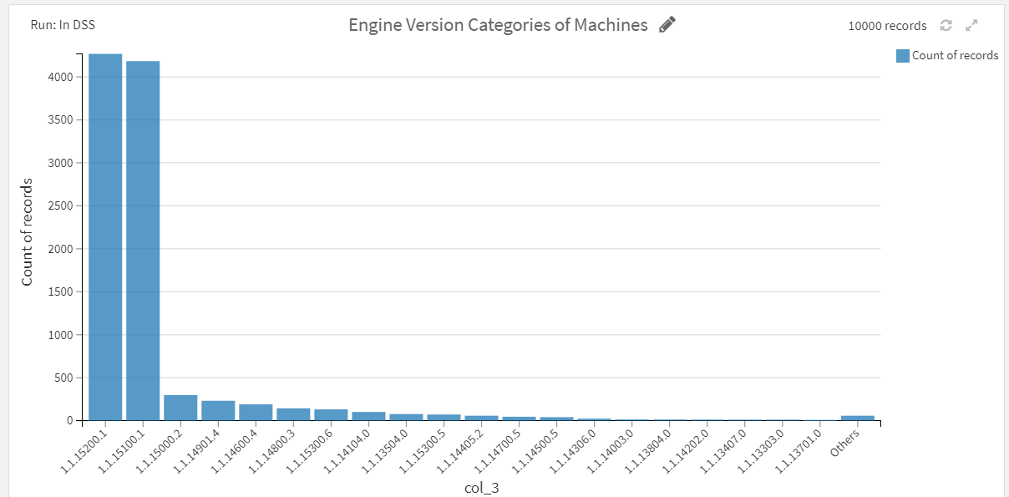
Quick Insights

Slide 7
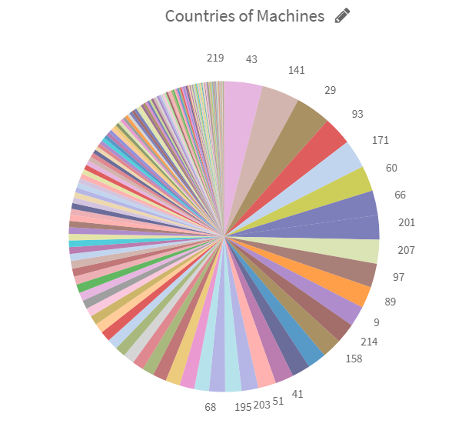
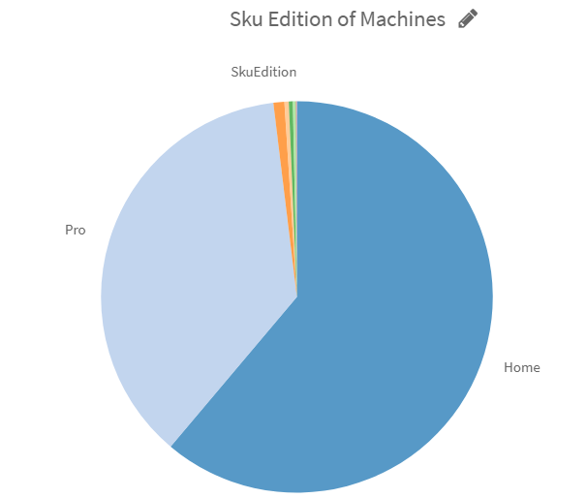
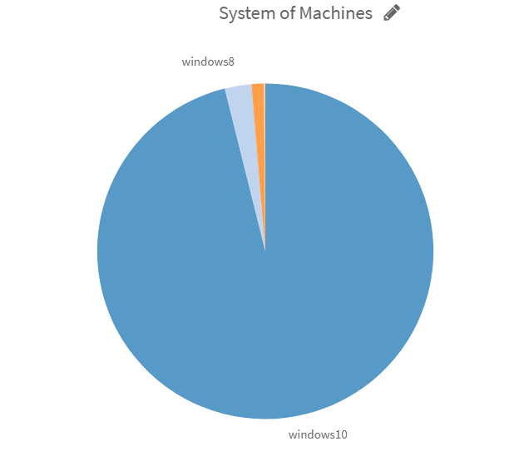
Quick Insights

Slide 8
Feature Engineering (Theory)
  To get the best possible results from a predictive model and avoid the model coming up with predictions that might seem to be accurate but which are just coincidences
What ?
  Basically it is the process of selecting and transforming input variables to come up with which predictor variables should be included in a model.
Why ?

Slide 9

Feature Engineering
A Convert data into categories
Census_PrimaryDisk Total Capacity Category
Engine Version Category
App Version Category
Smart Screen Category
AV Product States Identifier Category
Ie Ver Identifier Category
B Then convert them into integers
Reference Link: https://www.kaggle.com/rintaromasuda/logistic-regression-with-basic-feature-engineering by Rintaro Masuda

Slide 10
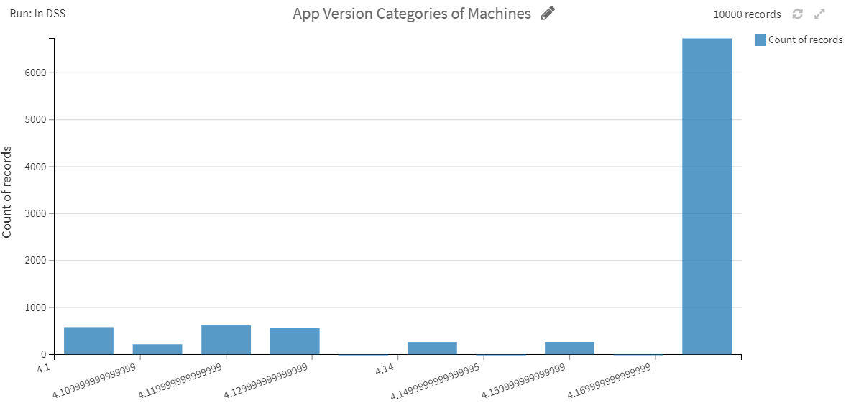
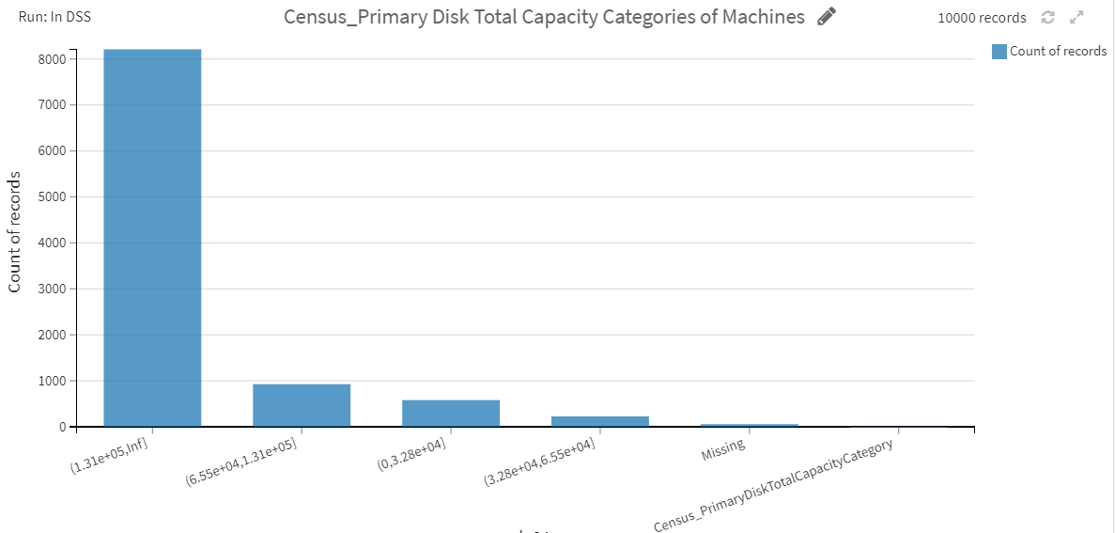
Feature Engineering (Processed Columns)

Slide 11
Feature Selection (Theory)
  To reduce the computational cost of modeling
  To improve the performance of the model
What ?
  FS is the process of reducing the number of input variables when developing a predictive model.
Why ?
Notes:
How ? By evaluating the relationship between each input variable and the target variable using statistics and selecting those input variables that have the strongest relationship with the target variable

Slide 12
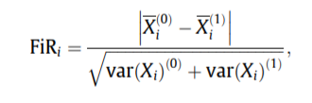
Fisher Score (Theory)
Why ?
  Typically used in Binary Classification Problems (Machine Harmed or not)
How ?
  The FiR is defined as the distance between the sample means for each class per feature divided by their variances:

Slide 13
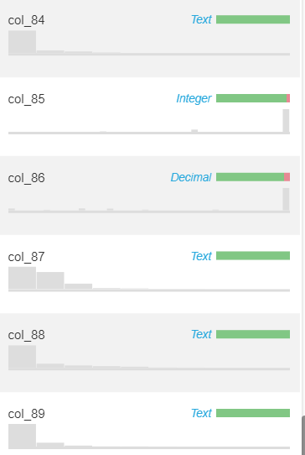
Fisher Score (code)
Top columns:
Census_PrimaryDiskTotalCapacityCategory
EngineVersionCategory
AppVersionCategory
SmartScreenCategory
AVProductStatesIdentifierCategory
IeVerIdentifierCategory

Slide 14
Model Building and
Hyper Parameter
selection

Slide 15
Model Building Procedure
Main Steps:
  Define the Resampling method
  Define the Model
  Define the Task
  Set hyper parameter tuning
  Run the Hyper Parameter tuning with K fold CV
  Extract best model

Slide 16
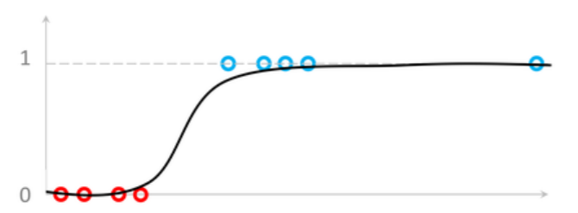
Logistic Regression (Theory)
Logistic Regression measures the relationship between the dependent variable and our features, by estimating probabilities using it’s underlying logistic function.
These probabilities must then be transformed into binary values in order to actually make a prediction. This is the task of the logistic function, also called the sigmoid function.

Slide 17
Logistic Regression
1
2
Resampling (Next Section)
rdesc = makeResampleDesc("CV", iters=5, predict="both")
Define the Model
learner <- makeLearner("classif.logreg", predict.type="prob", fix.factors.prediction=T)
4
5
Set hyper parameter tuning
-
Standard tuning used
3
Extract the best model
best_learner <- res$learner
} else {
res <- resample(learner, train_task, rdesc, measures=list(mlr::auc, setAggregation(mlr::auc, train.mean)))
best_learner <- learner }
Define the Task
train_task <- makeClassifTask(id="train", data=train_processed, target="HasDetections")

Slide 18
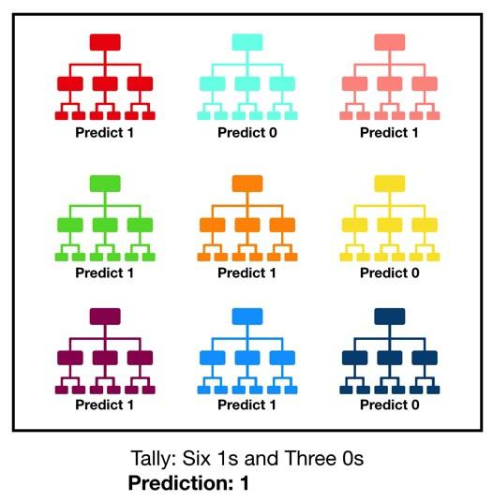
Random Forest (Theory)
Random forest consists of a large number of individual decision trees that operate as an ensemble. Each individual tree in the random forest spits out a class prediction and the class with the most votes becomes our model’s prediction

Slide 19
Random Forest
2
1
Define the Model
learner <- makeLearner("classif.randomForest", predict.type="prob", fix.factors.prediction=T)
Resampling (Next Section)
rdesc = makeResampleDesc("CV", iters=5)
4
Set hyper parameter tuning
tune_params <- makeParamSet(
makeDiscreteParam('ntree', value=c(100, 250, 500, 750, 1000)),
makeDiscreteParam('mtry', value=round(sqrt((ncol(train_processed)-1) * c(0.1, 0.25, 0.5, 1, 2, 4))))
)
ctrl = makeTuneControlGrid()
if (length(tune_params$pars) > 0) {
# Run parameter tuning
res <- tuneParams(learner, task=train_task, resampling=rdesc,
par.set=tune_params, control=ctrl, measures=list(mlr::auc))
5
3
Extract the best model
best_learner <- res$learner
} else {
# Simple cross-validation
res <- resample(learner, train_task, rdesc, measures=list(mlr::auc))
# No parameter for tuning, only 1 best learner
best_learner <- learner
}
Define the Task
train_task <- makeClassifTask(id="train", data=train_processed, target="HasDetections")

Slide 20
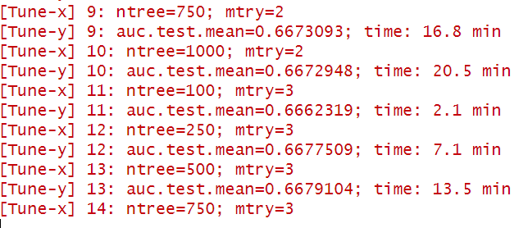
HyperParameter Tuning comparison
'ntree', value=c(100, 250, 500, 750, 1000)),
'mtry',
value=round(sqrt((ncol(train_processed)-1) * c(0.1, 0.25, 0.5, 1, 2, 4))))
5 folds cross validation
Notes:
mtry = Number of drawn candidate variables in each split

Slide 21
Resampling method

Slide 22
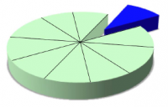
Resampling
What ?
Resampling method are a class of methods that estimate the test error by holding out a subset of the training set from the fitting process, and then applying the statistical learning method to those held out observations.
What did we used?
Cross Validation:
  You divide at random the samples into K parts with a size about the same.
  K-fold cross-validation will be done K times. In each stage, one fold gets to play the role of validation set whereas the other remaining parts (K-1) are the training set.
  For each stage, cross-validation involves removing part of the data, then holding it out, fitting the model to the remaining part, and then applying the fitted model to the data that we've held out.

Slide 23
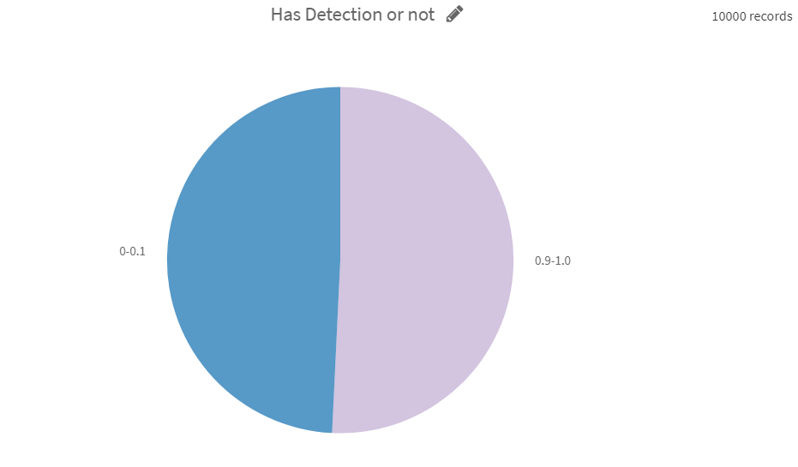
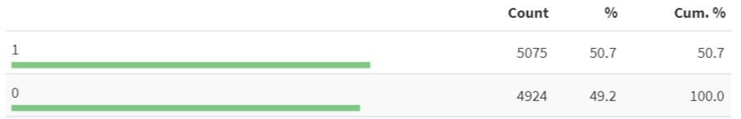
Target Variable

Slide 24
Model Assessment and Results

Slide 25
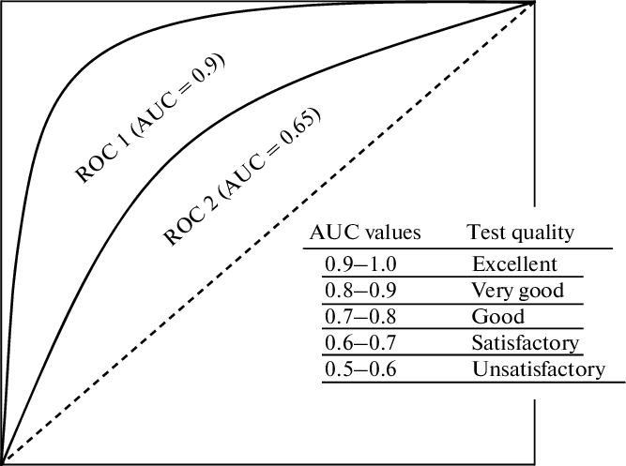
Model Assessment: AUC
How is it used ?
AUC - ROC curve is a performance measurement for classification problems. ROC is a probability curve and AUC represents degree or measure of separability. It tells how much model is capable of distinguishing between classes. Higher the AUC, better the model is at predicting 0s as 0s and 1s as 1s. By analogy, Higher the AUC, better the model is at distinguishing between a Machine with Malware and another one without.

Slide 26
Models Results
Random Forrest:
Best HyperParameters: ntree=1000; mtry=3
AUC: 0.6683346;
Logistic Regression:
AUC: 0.6621682

Slide 27
THANK YOU

